Slide 1
Quantum Computing Architectures (EE274) Lecture 15
Hiu-Yung Wong
Mar. 18, 2025
hiuyung.wong@sjsu.edu, Office: ENG363
http://www.sjsu.edu/people/hiuyung.wong/index.html

Slide 2
Outline
Silicon Qubits

Slide 3
Spin Qubit Quantum Computer
Chapters 11 and 12 of “Quantum Computing Architecture and Hardware for Engineers: Step by Step”
This part has a lot of maths. You only need to be able to understand and derive them open-book (e.g. for assignment). But you need to understand what I am doing.

Slide 4
DiVincenzo's criteria for QC
From the last lecture
5 Necessary Criteria for quantum computing:
A scalable physical system with well characterized qubit (system needs to remain in the subspace of 2 level)
The ability to initialize the state of the qubits to a simple fiducial state (initialization time is important)
Long relevant decoherence times (much longer than gate time)
A "universal" set of quantum gates
A qubit-specific measurement capability (Some algorithms only works without measuring all qubits at the same time e.g. teleportation)
2 Necessary Criteria for quantum communication:
The ability to interconvert stationary and flying qubits (even one bit stationary and one bit flying)
The ability to faithfully transmit flying qubits between specified locations (without decoherence)

Slide 5
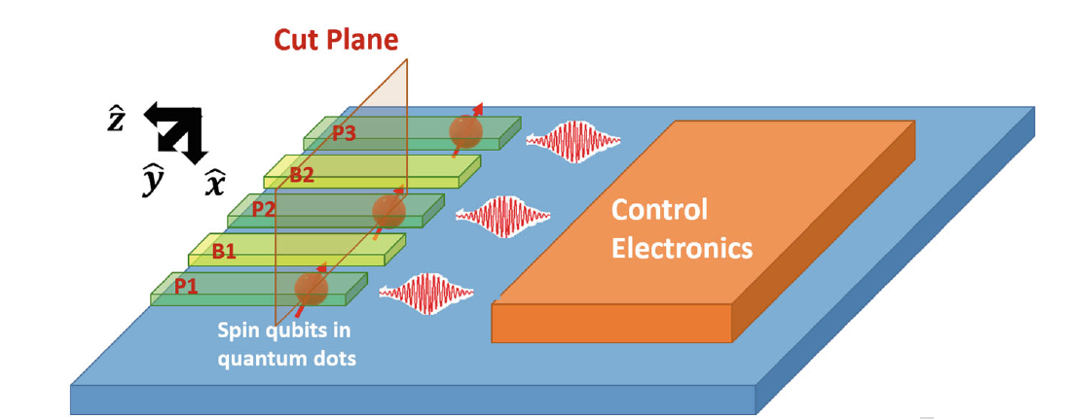
Why Silicon Spin Qubits
From the last lecture
Learning outcomes: Understand why Si Qubit is promising
Quantum Error Correction is one of the most promising way to protect the qubit
Likely, need 1000 physical qubits to form a robust logical qubit
For complex quantum algorithm, thousands of logical qubit are required => millions of physical qubits
Quantum processors likely needs to integrate with classical processors
Si qubit is the most promising from the integration perspective
Spin in electron
Spin in nucleus

Slide 6
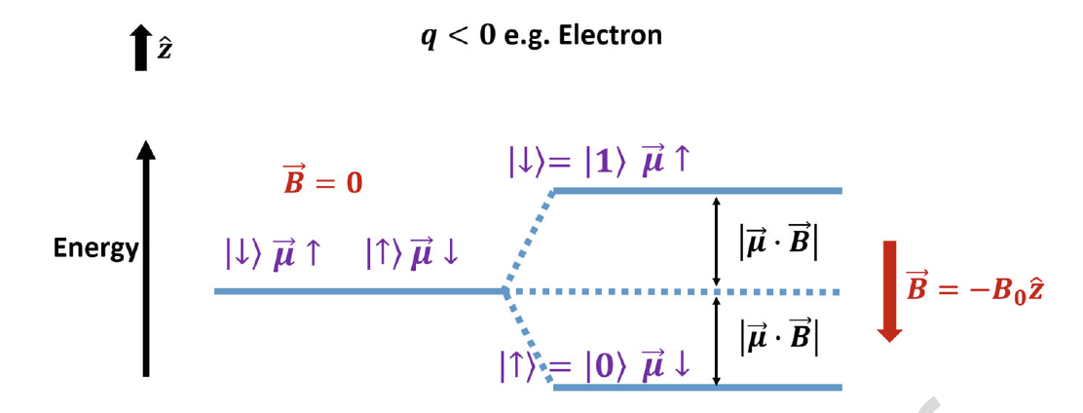
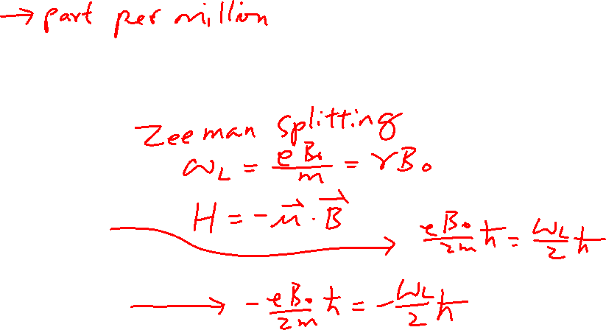
Properties of Si Spin-Qubit
From the last lecture
²⁸Si with no nuclear spin is used. Natural Si has 5% ²⁹Si. (Need to purify to 800ppm)
Magnetic field: 1.4T
Temperature: 50mK
T₂*=120us (without Echo)

Slide 7
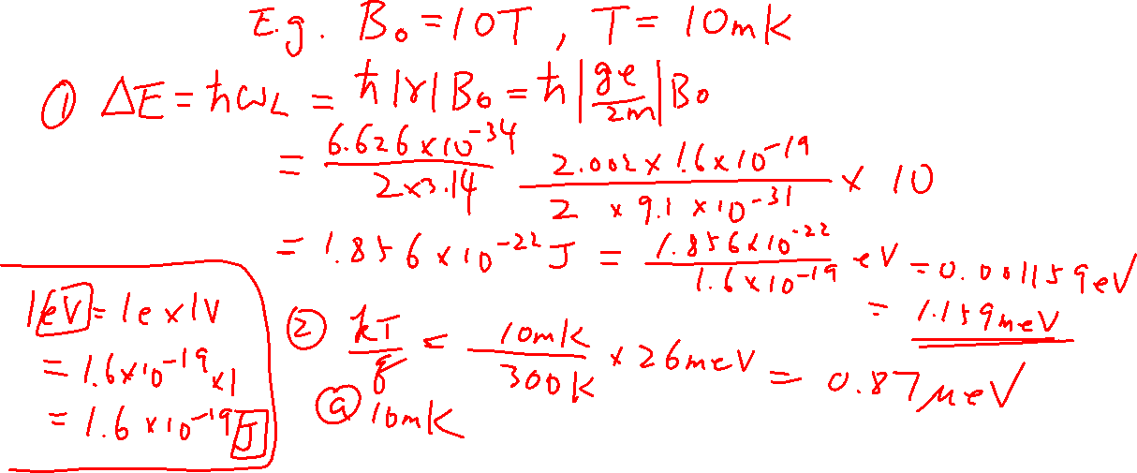
Sidenote: Calculation of Zeeman Splitting (Is it a good 2-level system compared to the thermal energy?)
From the last lecture

Slide 8
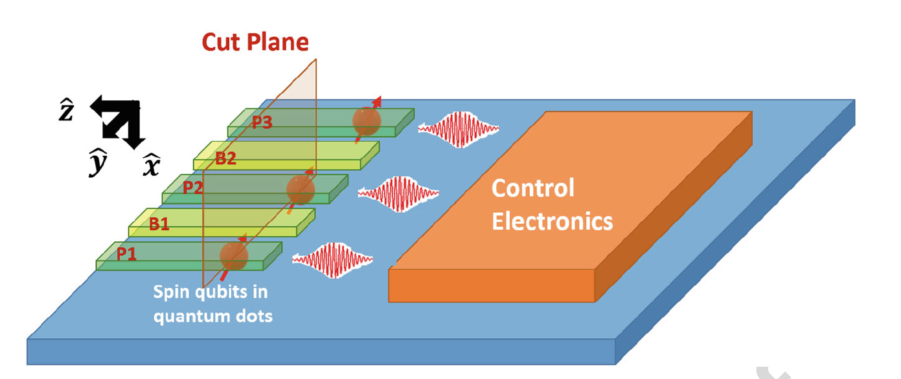
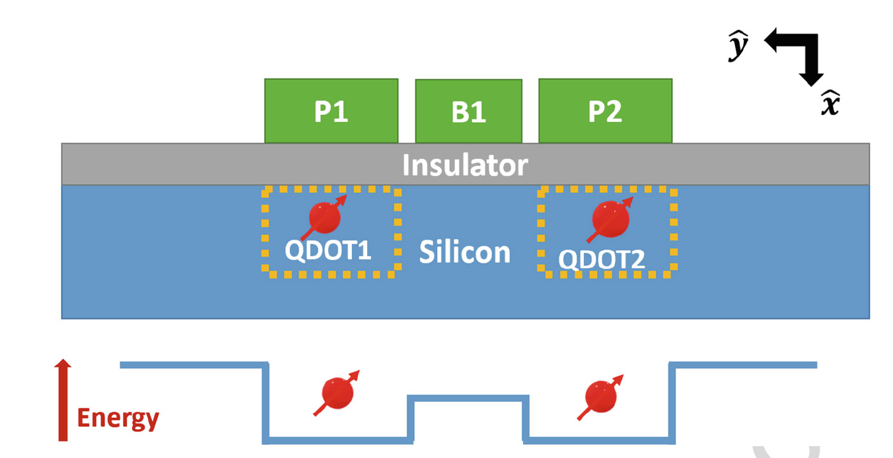
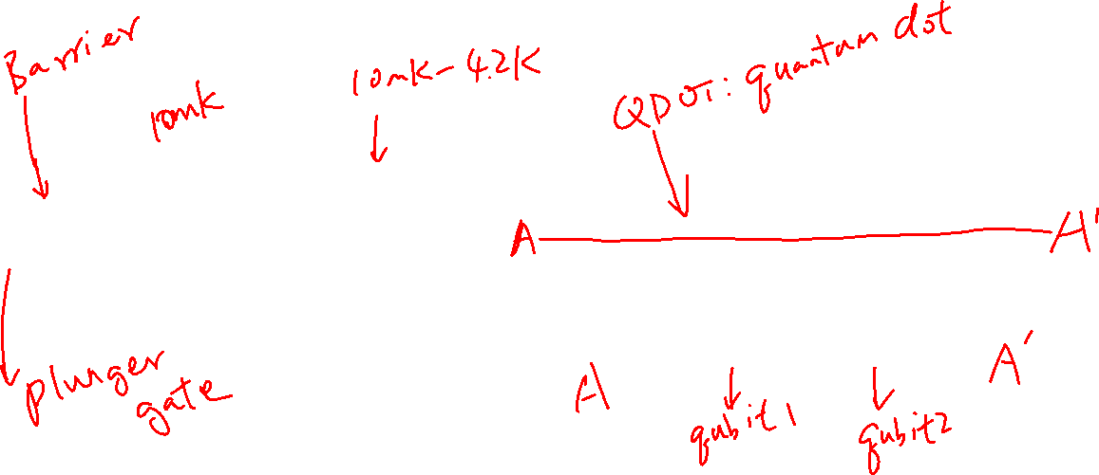
Storage of Electron Qubit

Slide 9
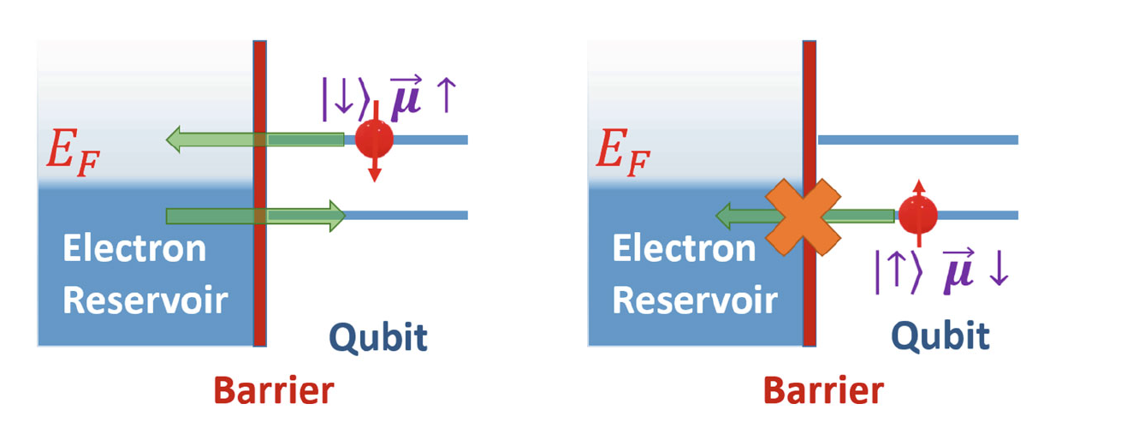
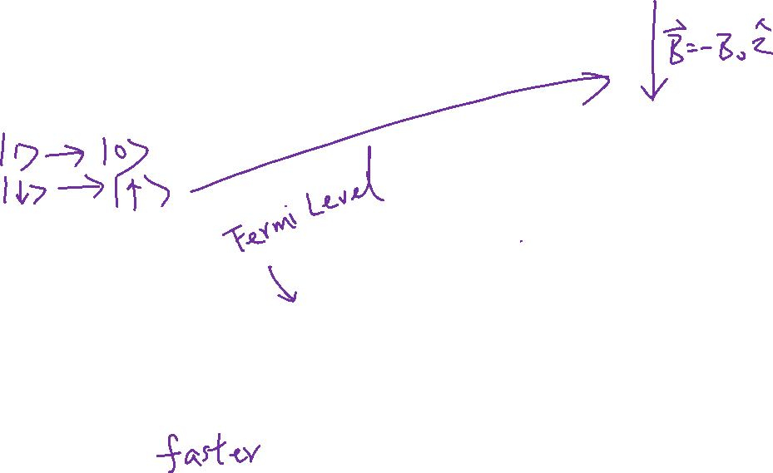
Initialization
E.g. 1: Thermalization: Slow (T₁)
E.g. 2:
Magnetic field is pointing down
Adjust quantum dot potential so that higher energy state (spin down) will tunnel to the reservoir => only lower energy state (spin up) left

Slide 10
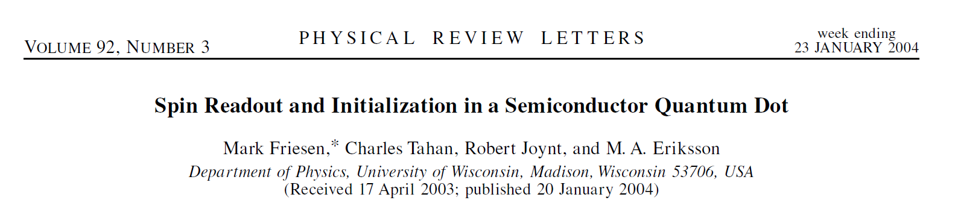
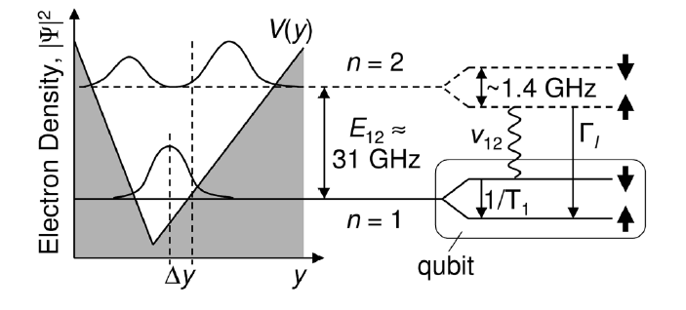
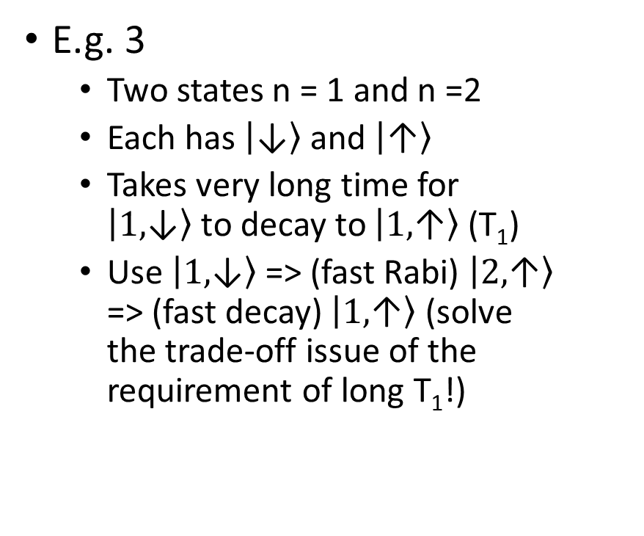
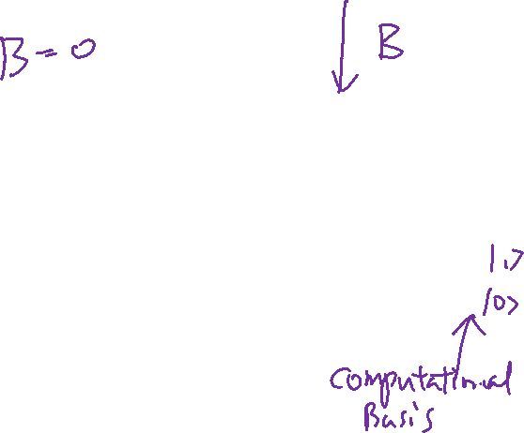
Initialization
E.g. 3
Two states n = 1 and n =2
Each has $\left|\left.\text{↓}\right\rangle \right.$ and $\left|\left.\text{↑}\right\rangle \right.$
Takes very long time for $\left|\left.\text{1,}\text{↓}\right\rangle \right.$to decay to $\left|\left.\text{1,}\text{↑}\right\rangle \right.$ (T₁)
Use $\left|\left.\text{1,}\text{↓}\right\rangle \right.$ => (fast Rabi) $\left|\left.\text{2}\text{,}\text{↑}\right\rangle \right.$ => (fast decay) $\left|\left.\text{1,}\text{↑}\right\rangle \right.$ (solve the trade-off issue of the requirement of long T₁!)

Slide 11
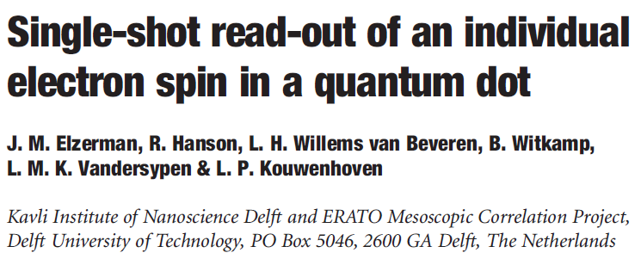
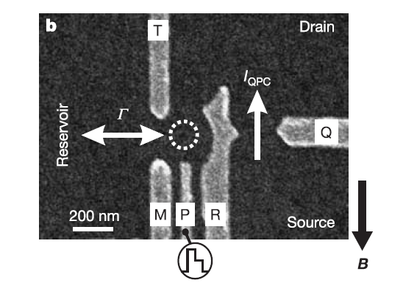
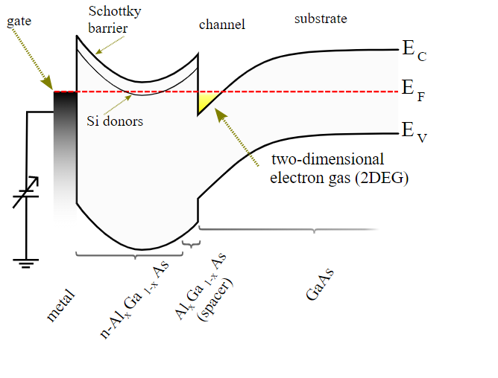
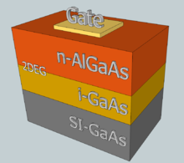
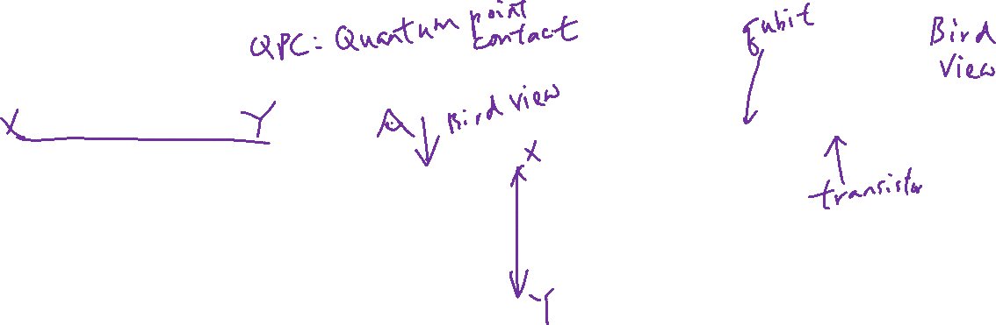
Read-out: Spin to Charge Conversion
Spin sensing is difficult
B is pointing down (in plane of 2DEG)
GaAs/AlGaAs 2DEG
QPC Channel use to detect the charge in the quantum dot – 8μs (10X faster than Γ)
M, R, T form the side wall barrier
P: Gate to control electron numbers
Γ: 2E4/s = (0.05ms)⁻¹
Wiki

Slide 12
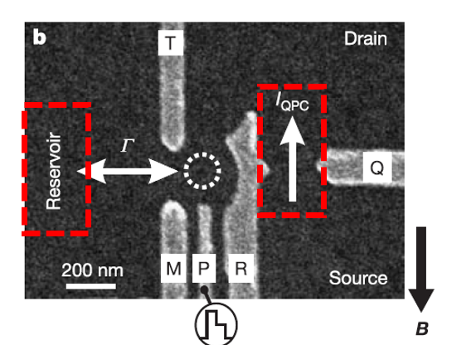
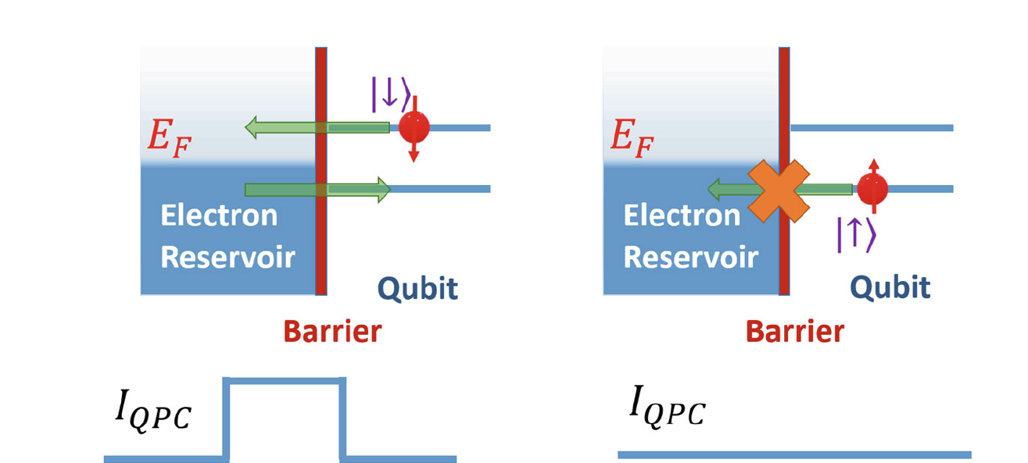

Read-out: Spin to Charge Conversion
Remember: B is down, so spin down has a higher energy; There is capacitive coupling between V_{P} and QPC

Slide 13
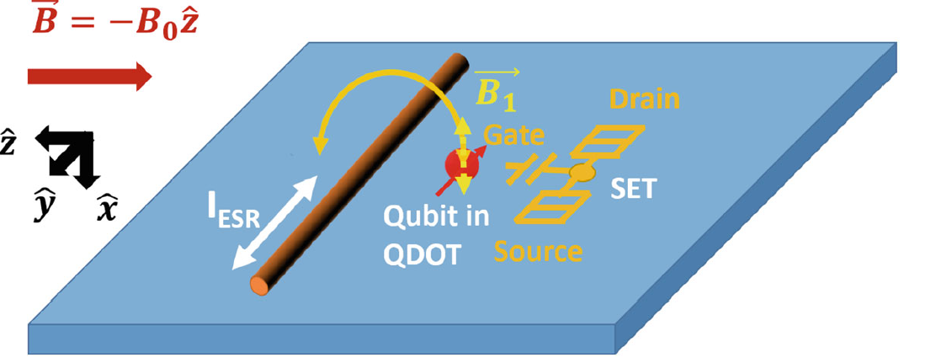
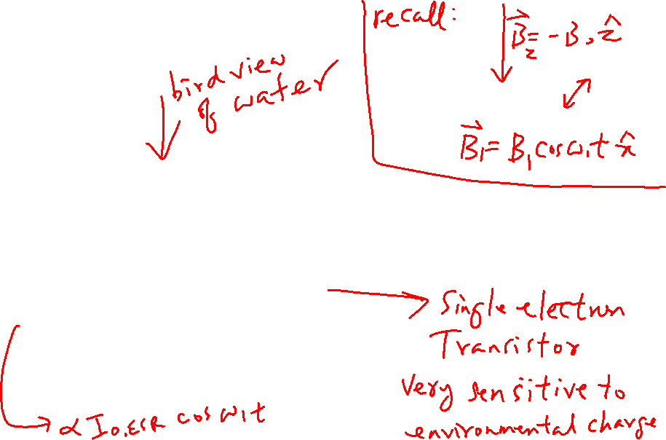
1-Qubit Gate Implementation

Slide 14
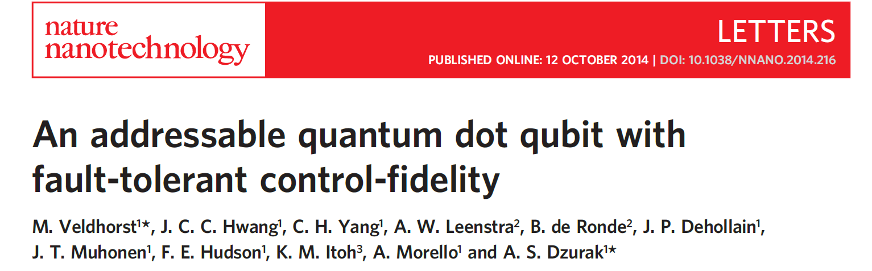
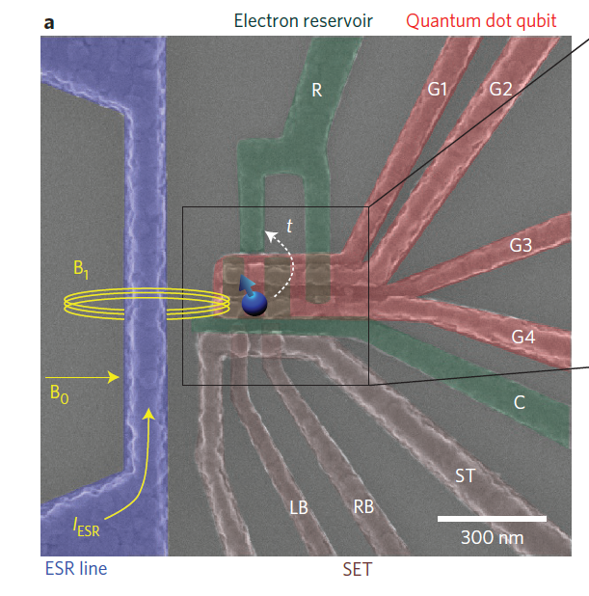
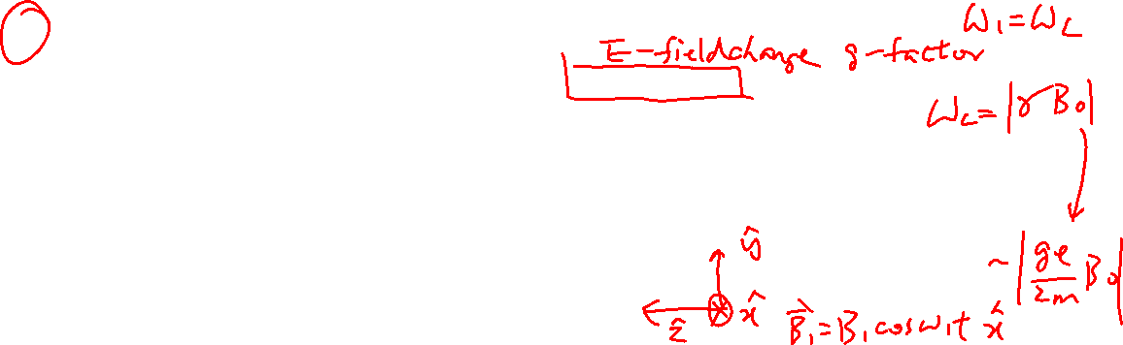
Case 2: Setup
²⁹Si: 800ppm to enhance qubit coherence time
Use Electron Spin Resonance (ESR) (i.e. Rabi oscillation with oscillating magnetic field to control qubit)
Use Stark Effect to control Larmor Frequency (ESR frequency)
Single Electron Transistor (SET): sense electron occupancy in quantum dot
1.4T, 50mK
Reservoir
Confinement due to C
SET

Slide 15
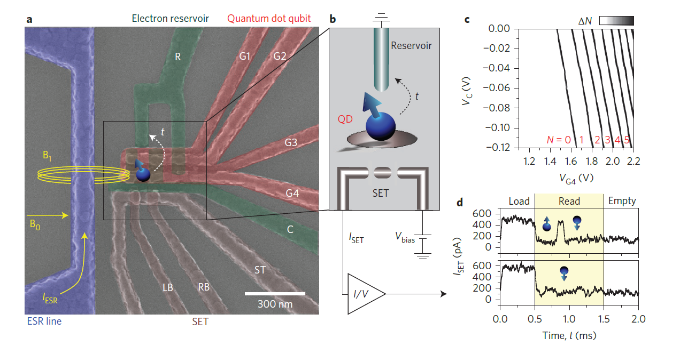
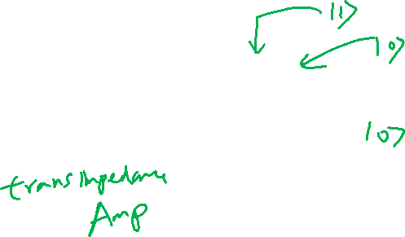
Case 2: Readout

Slide 16
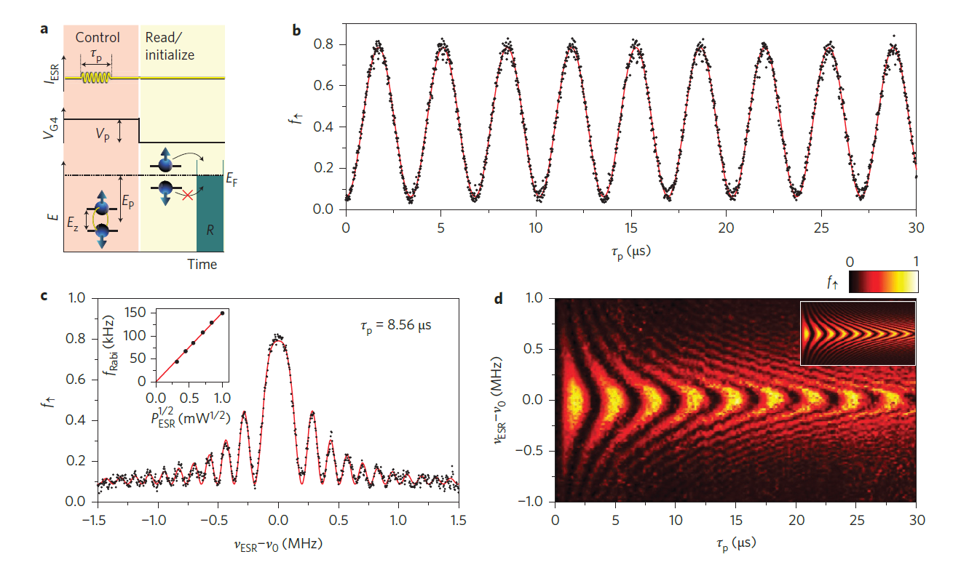
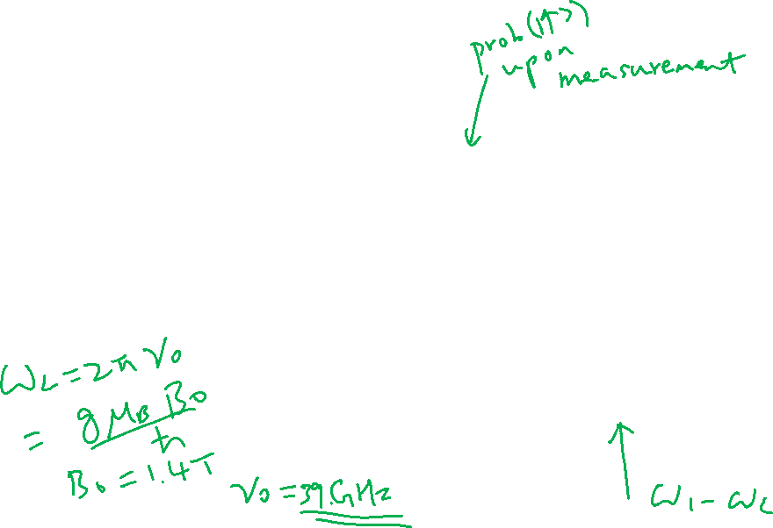
Case 2: Rabi Oscillation (Single qubit gate)

